Slide 1
Beautiful Patterns – Day 1
:D
Notes:
Throughout the day: collaborative wall

Slide 2
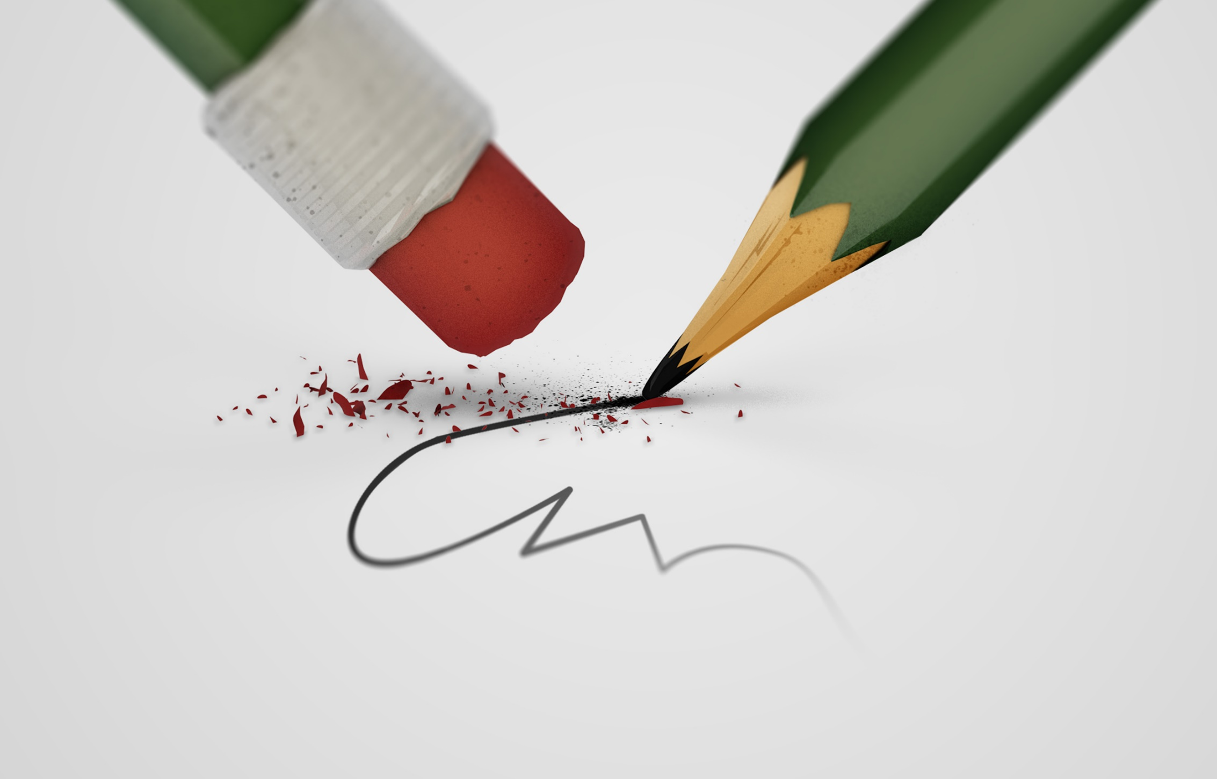
Warm Up: Draw an engineer

Slide 3

Welcome!
Let’s make teams

Slide 4
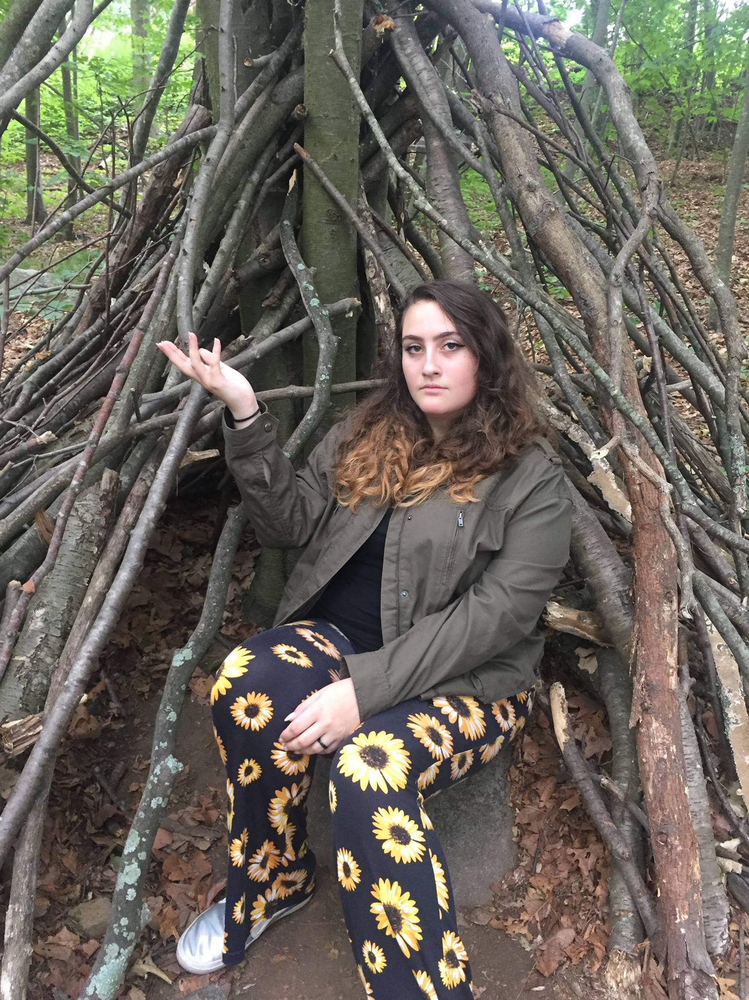
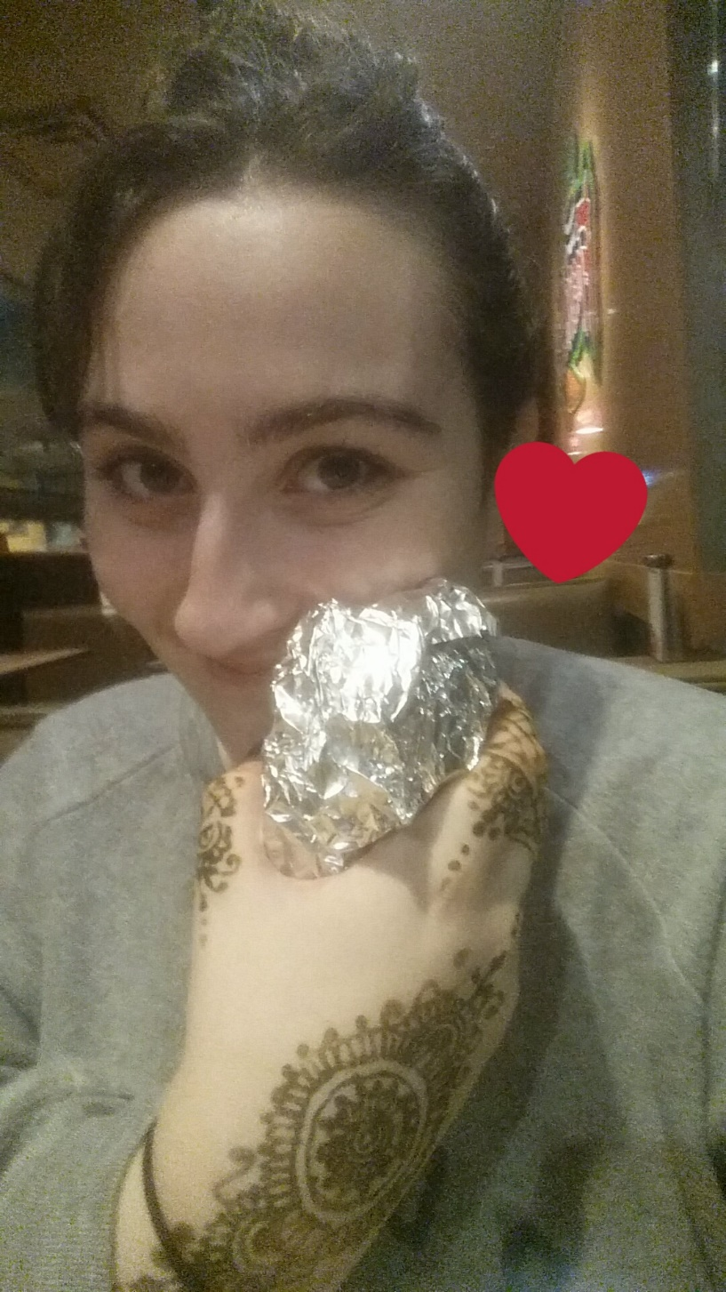
Who am i?
Nomi !!
One year left at University of Connecticut
I study Statistics, Computer Science, and Anthropology
I speak Russian!

Slide 5
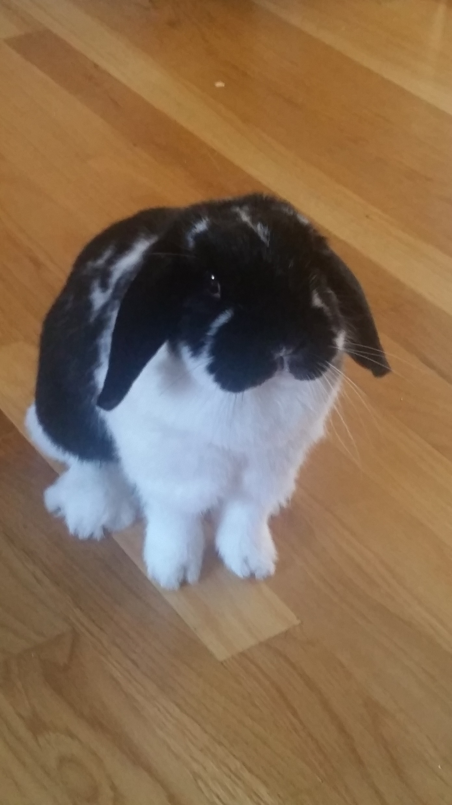
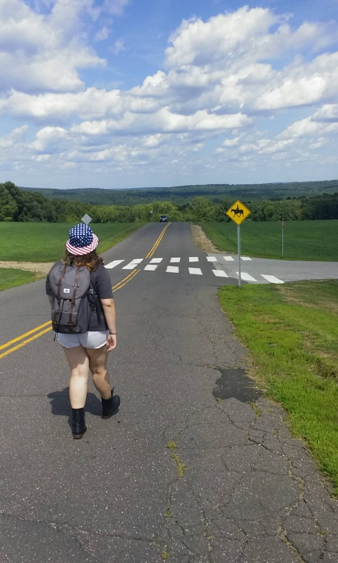
Who Am I (continued)
I like art, nature, rabbits, and music
I’m from Boston, Massachusetts
This is my first time in Mexico and I don’t speak Español :O

Slide 6
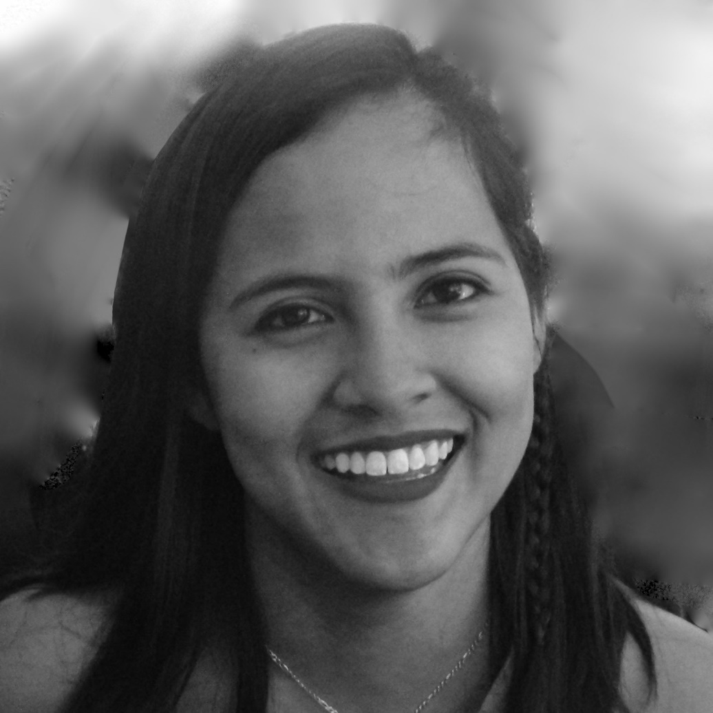
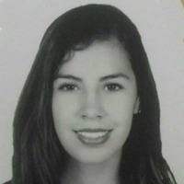

Who are our Tas?
Ilse
Angélica
Daniela

Slide 7
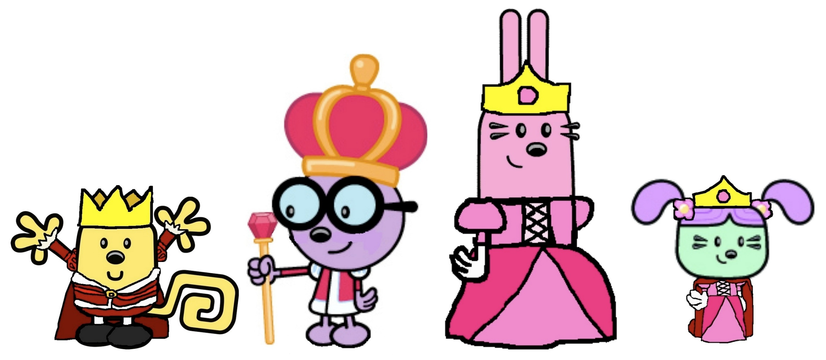
Who are you?
1 Name!
2 Reasons that you’re here!
3 Hobbies/what you do
4 Things you like!

Slide 8

Patterns
What is a pattern?

Slide 9
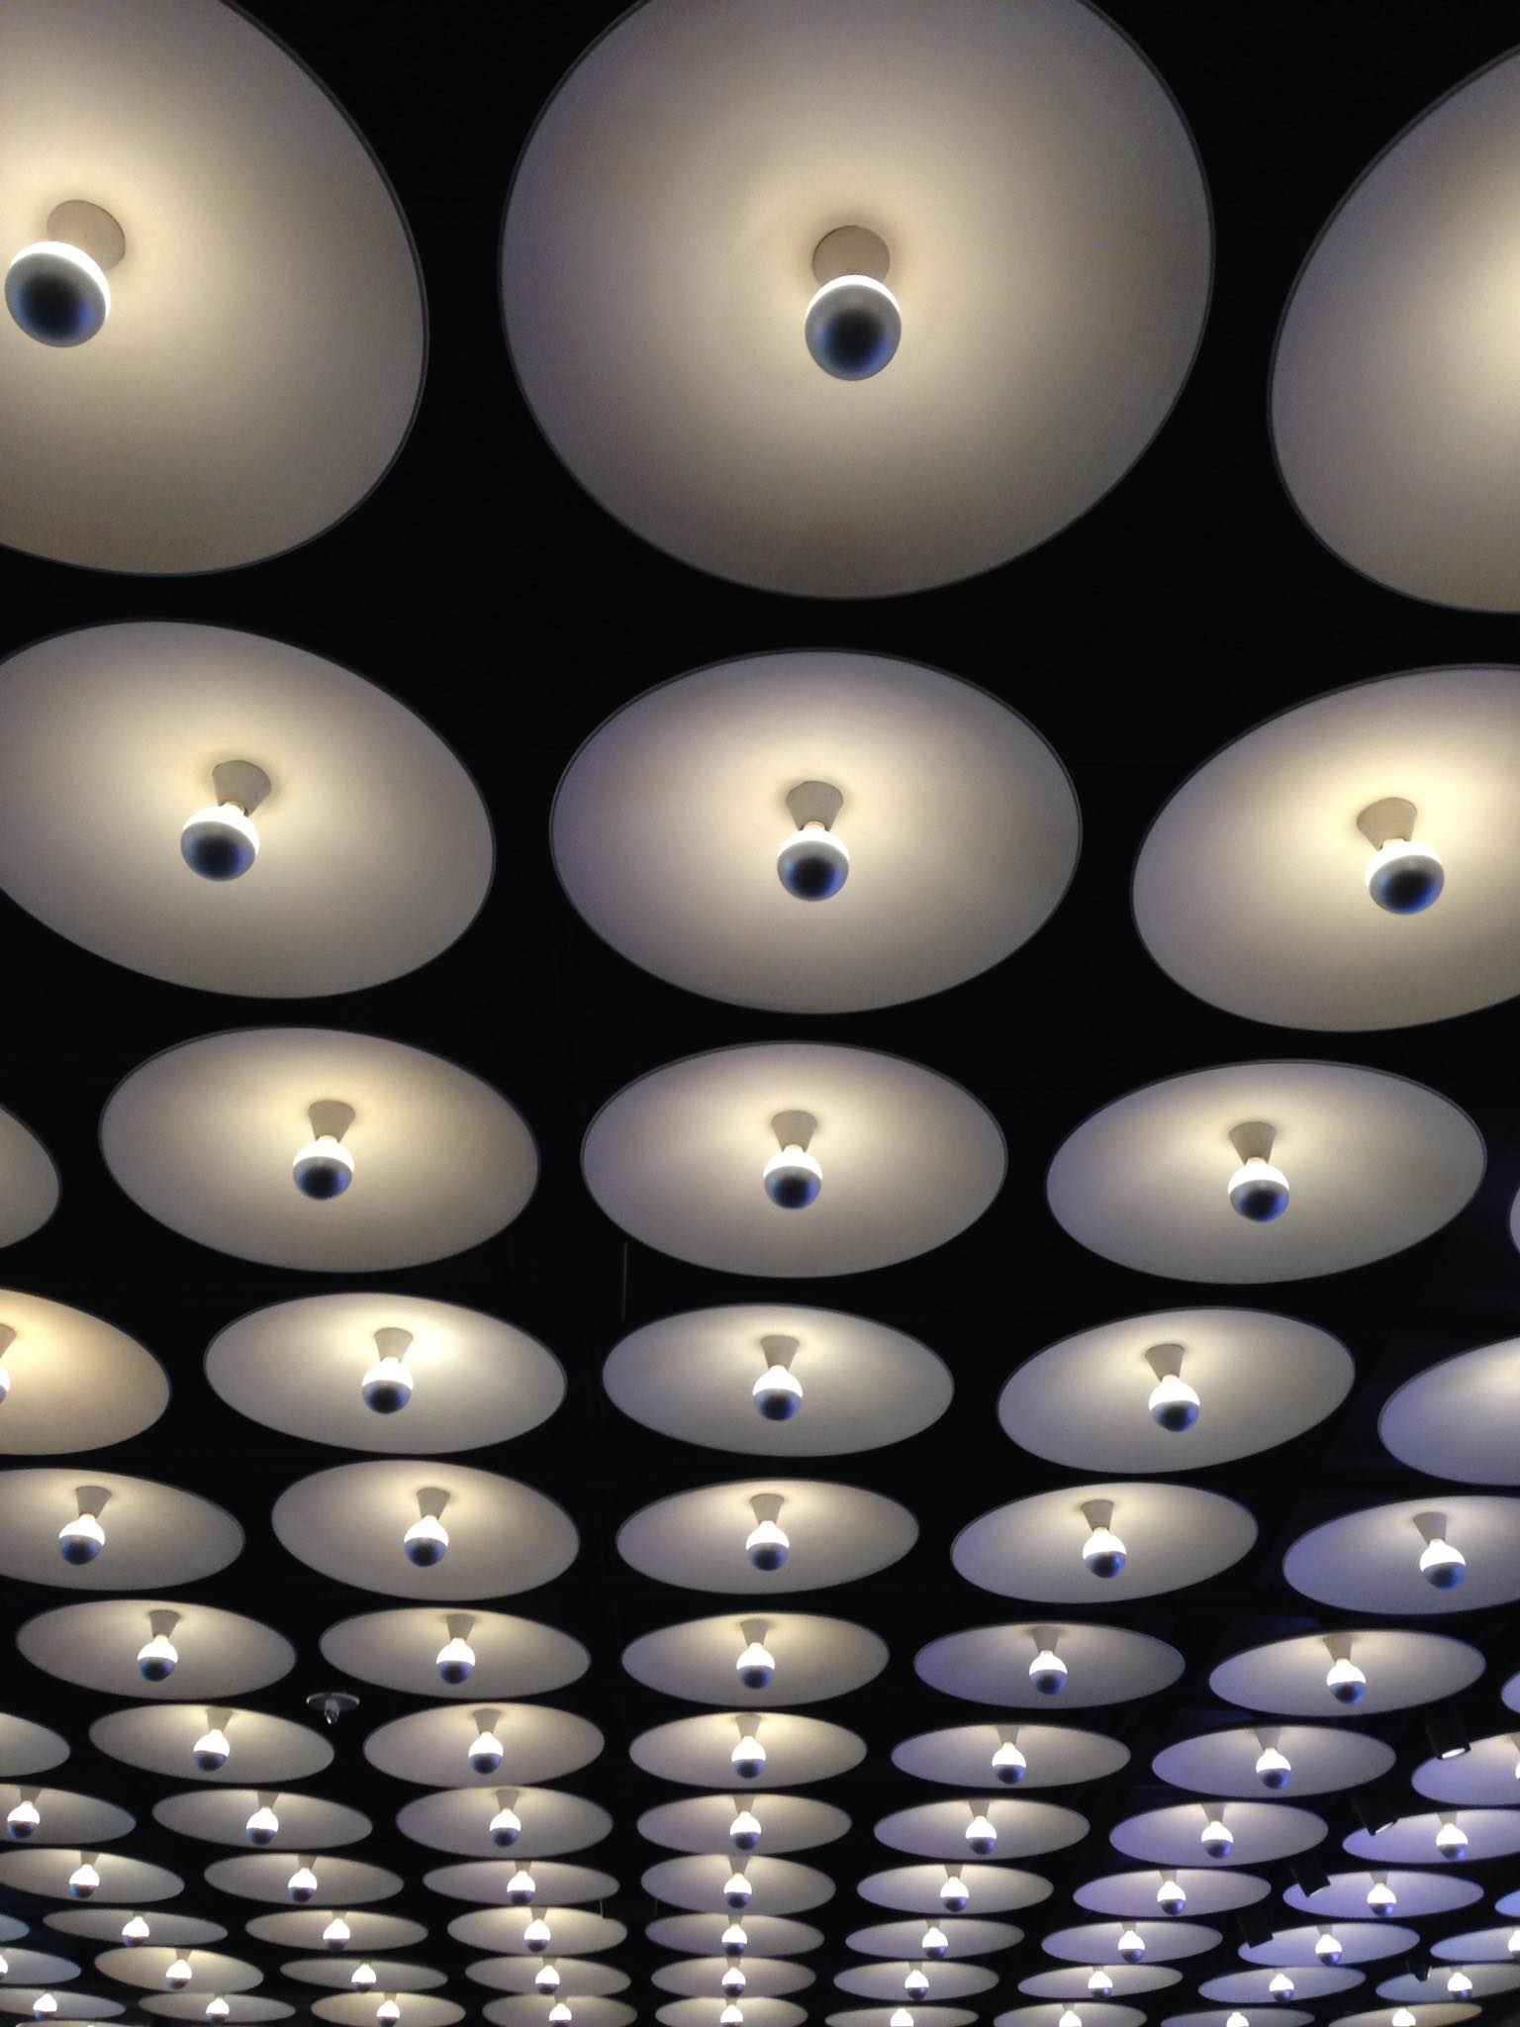

Slide 10
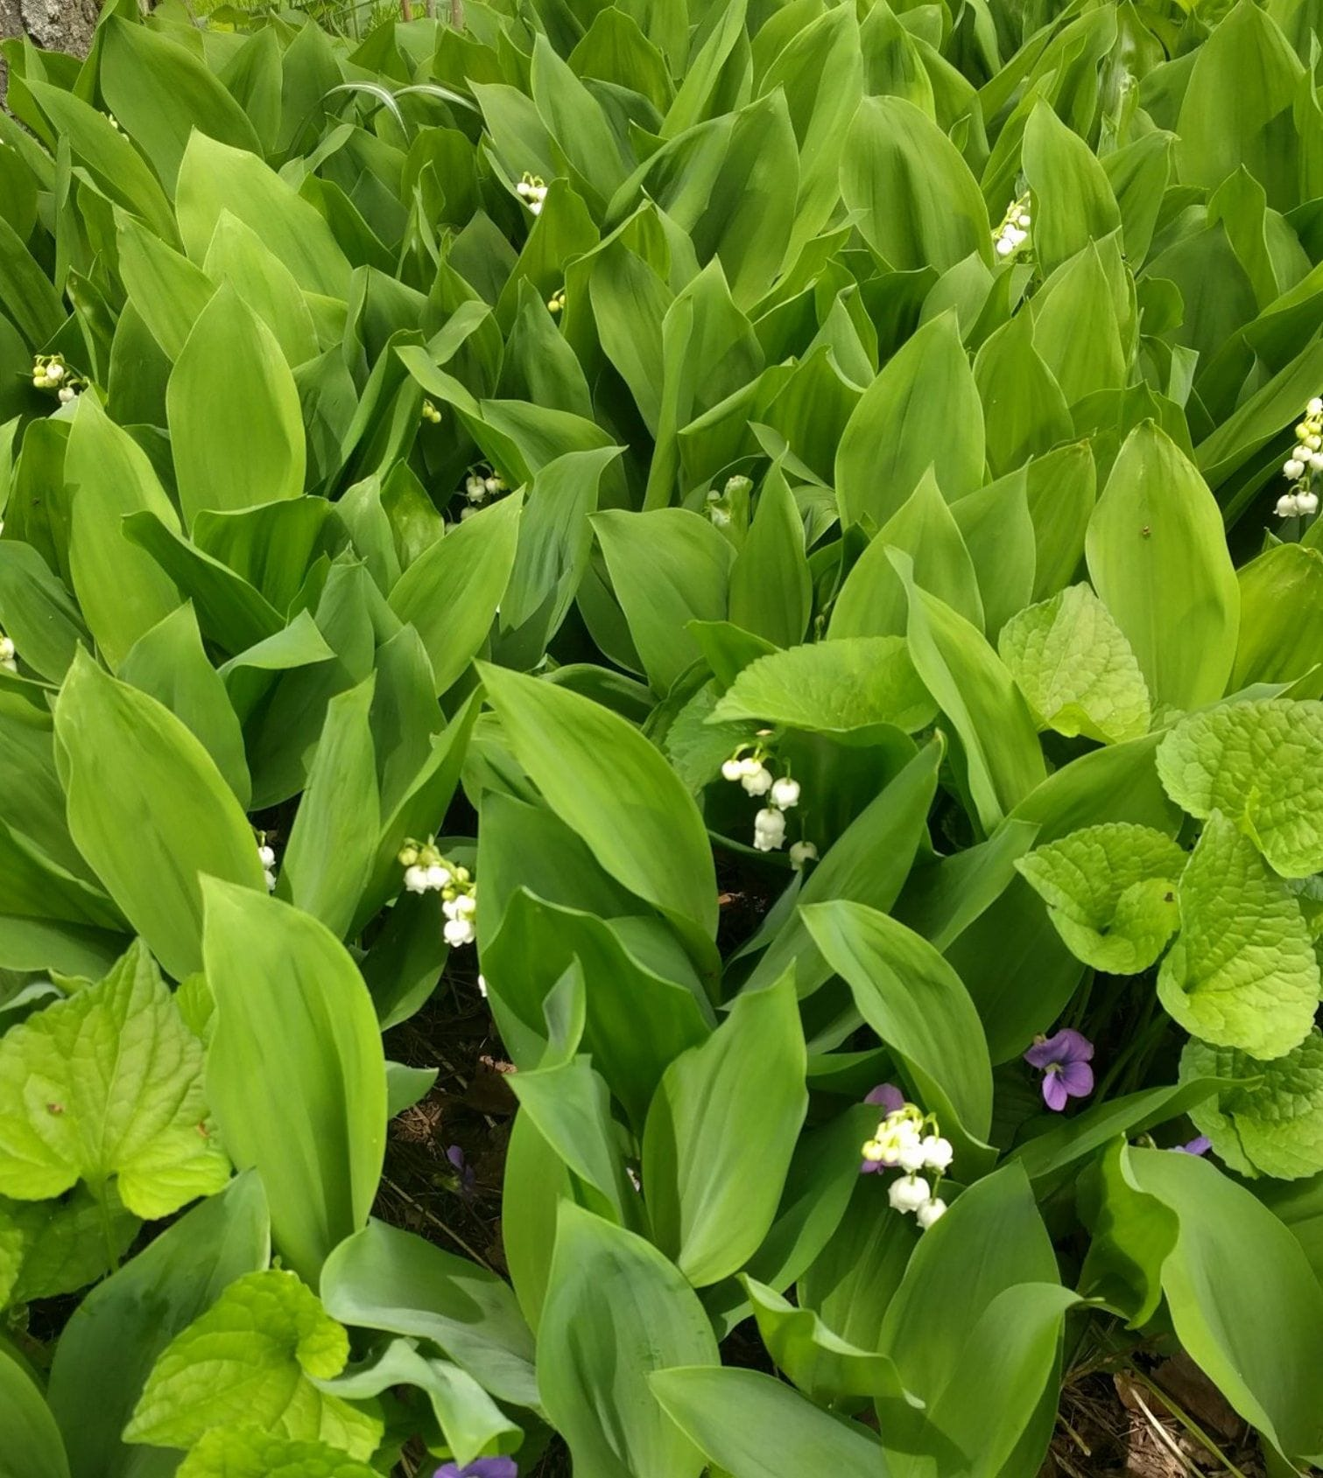

Slide 11

So what is it?
Where can we find patterns?
Visual?
Audio?
Action?

Slide 12
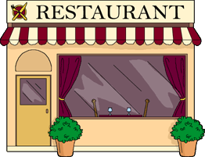
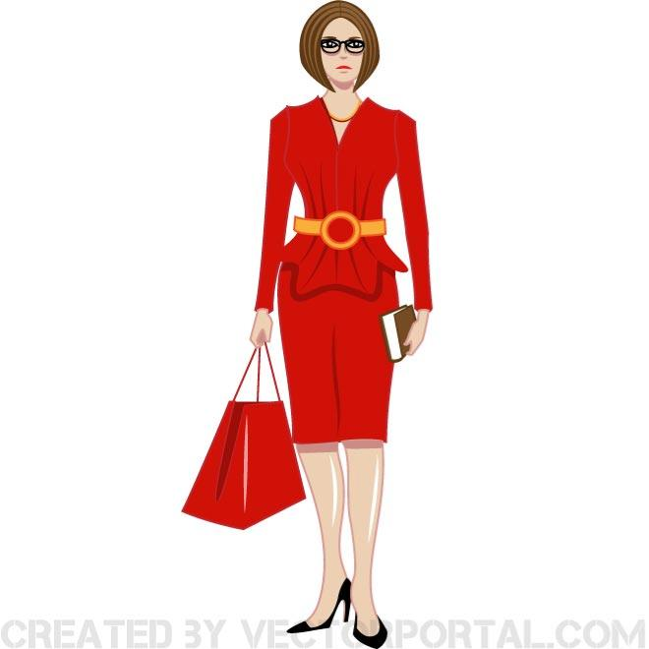
What happens when we go to a restaurant?

Slide 13
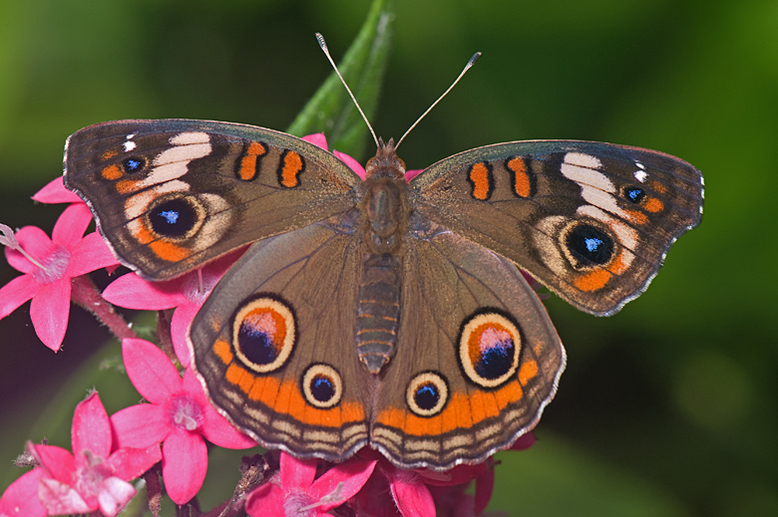
A Pattern we saw today
How did I choose your teams?
Have you seen any other patterns today?

Slide 14
Gale-Shapley – How to find a partner
How can we maximize happiness for people looking to date someone?
Let’s play the dating game:
1st choice: 4 points
2nd choice: 3 points
3rd choice: 2 points
4th choice: 1 point

Slide 15
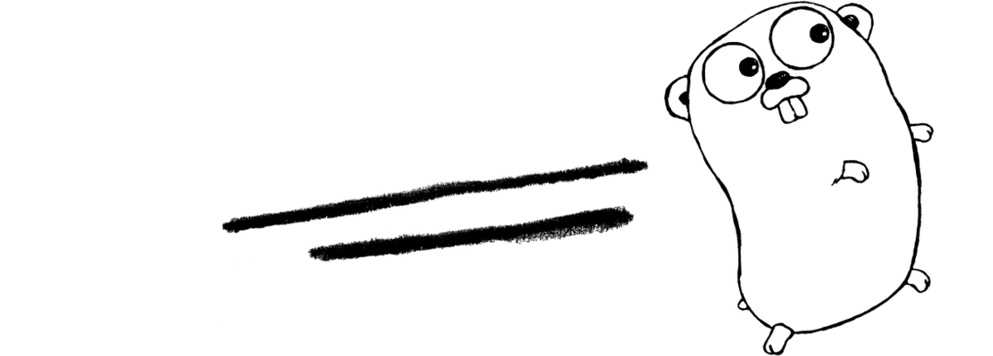

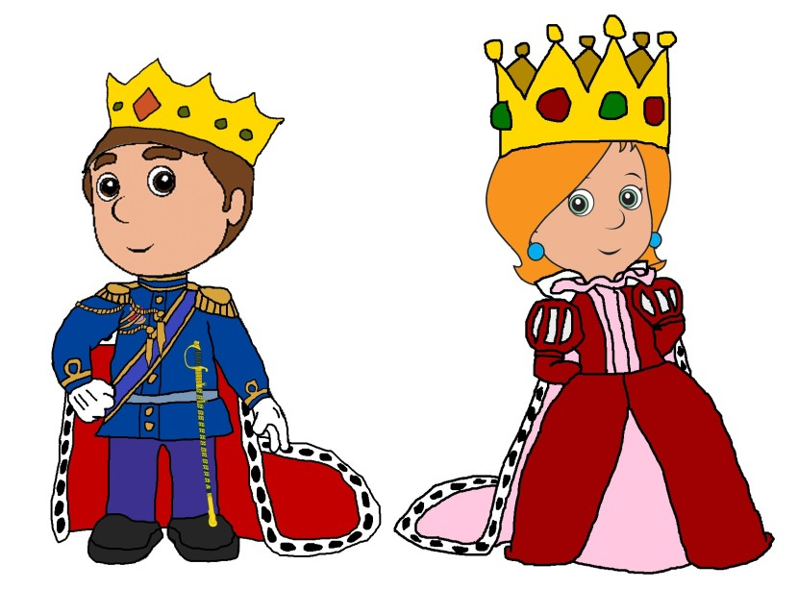
Go Go Go!
This Photo by Unknown Author is licensed under CC BY-SA

Slide 16
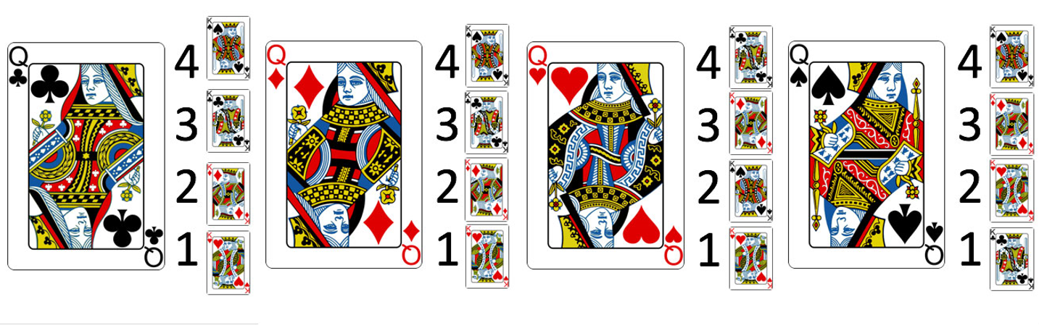
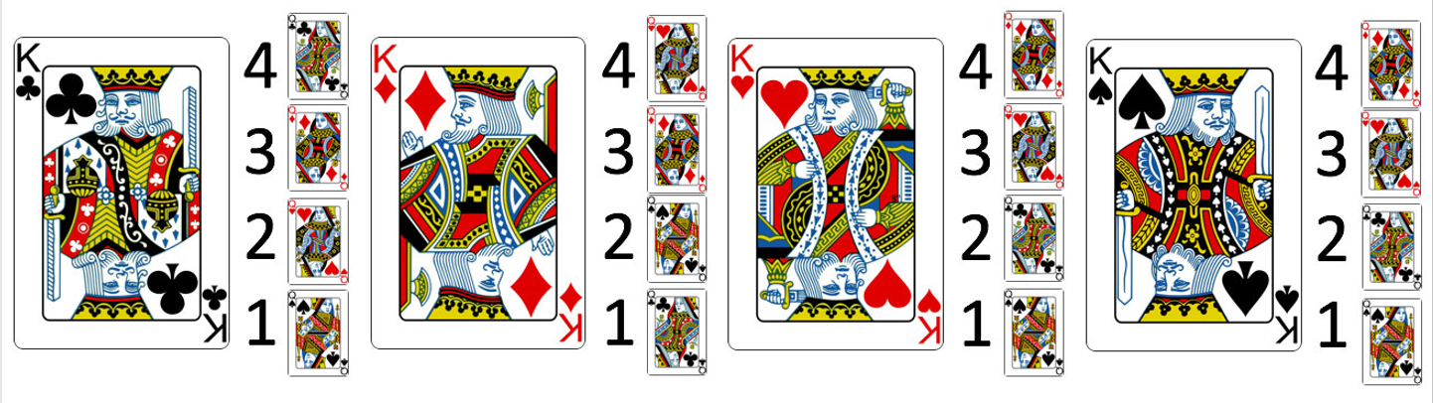
Preferences

Slide 17
Solution
It’s really just a simple pattern….

Slide 18
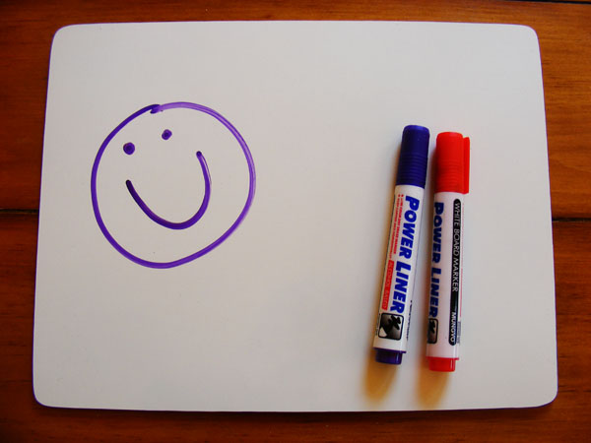
Other ways to use this pattern?
Create your own problem!
Show the class how you solve the problem

Slide 19
Break
Lunch
Notes:
Make new teams for the project

Slide 20
How is a computer like a restaurant?

Slide 21
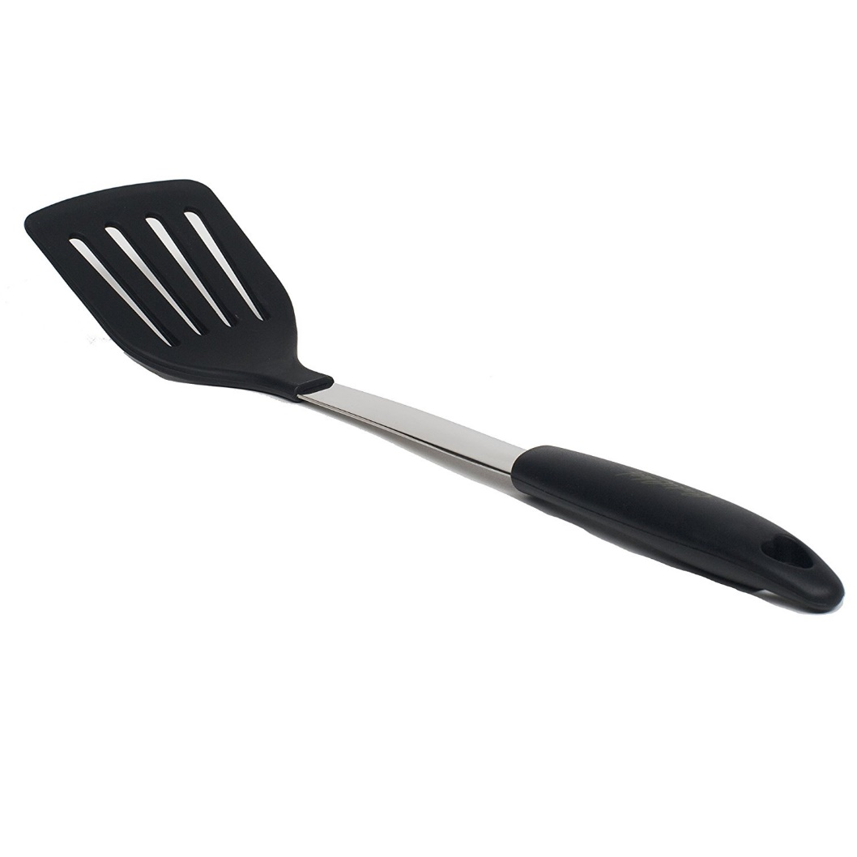
The Computer is the kitchen
Customer is the user– creating directions and tasks for the kitchen
Waiters/Chefs follow the rules that the manager put in place
We are the managers when we write code!

Slide 22
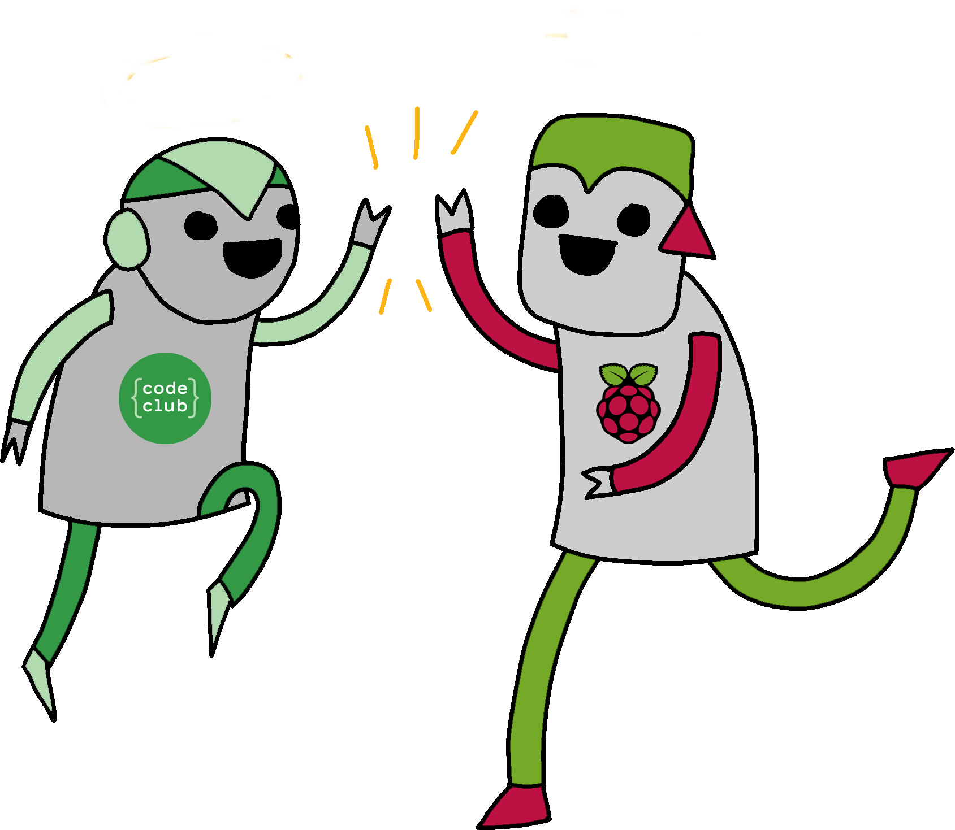
Coding
Websites are built with code
HTML: Provides the basic outline of content for the page
CSS: Makes the website look pretty
JavaScript: Makes cool customized effects
This Photo by Unknown Author is licensed under CC BY-SA

Slide 23
HTML
Hypertext Markup Language
Tags different parts of the website to make them look and function in different ways
<div> </div>
<p> </p>
<b> These words will be bold </b> but these will not.

Slide 24

HTML
Open a notepad file
Save as “hello.html”
Write something (“Hello World!”)
Open the file
This Photo by Unknown Author is licensed under CC BY
Notes:
Add <h1>….</h1>

Slide 25
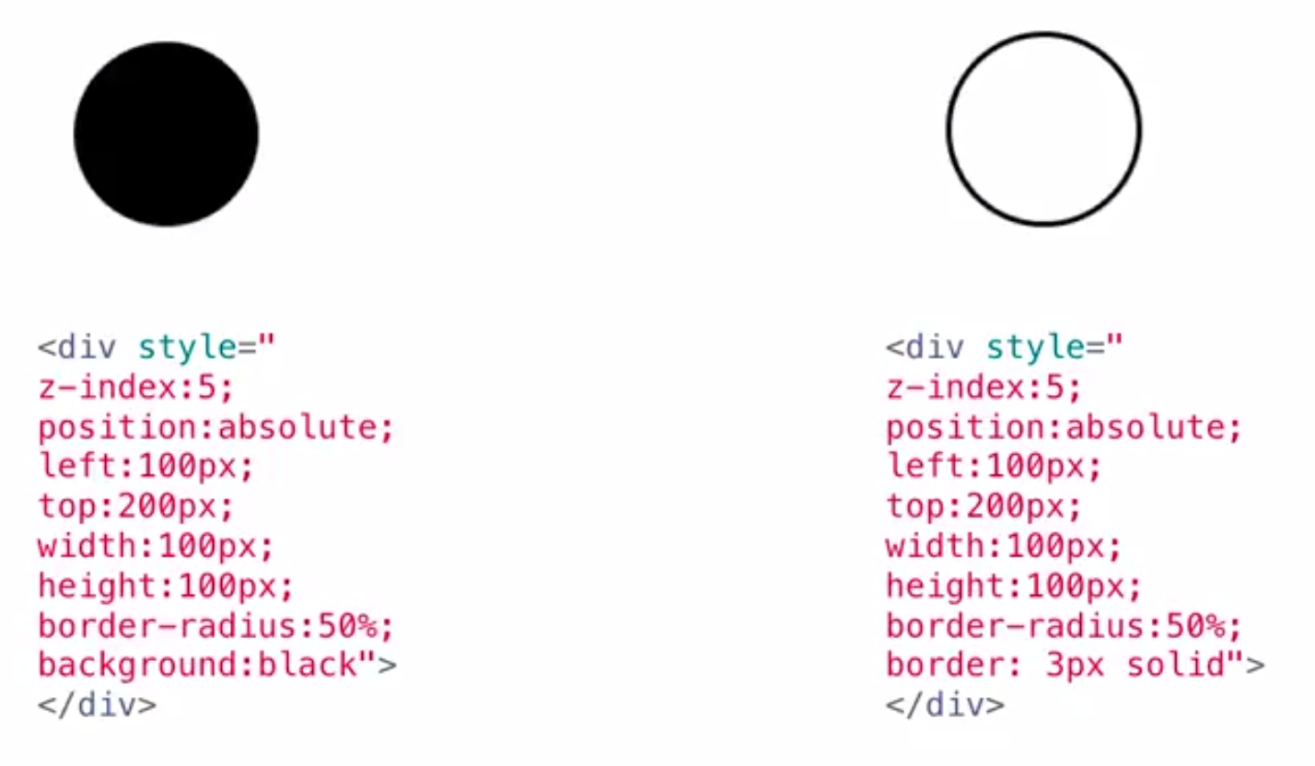
Let’s make shapes - CSS

Slide 26
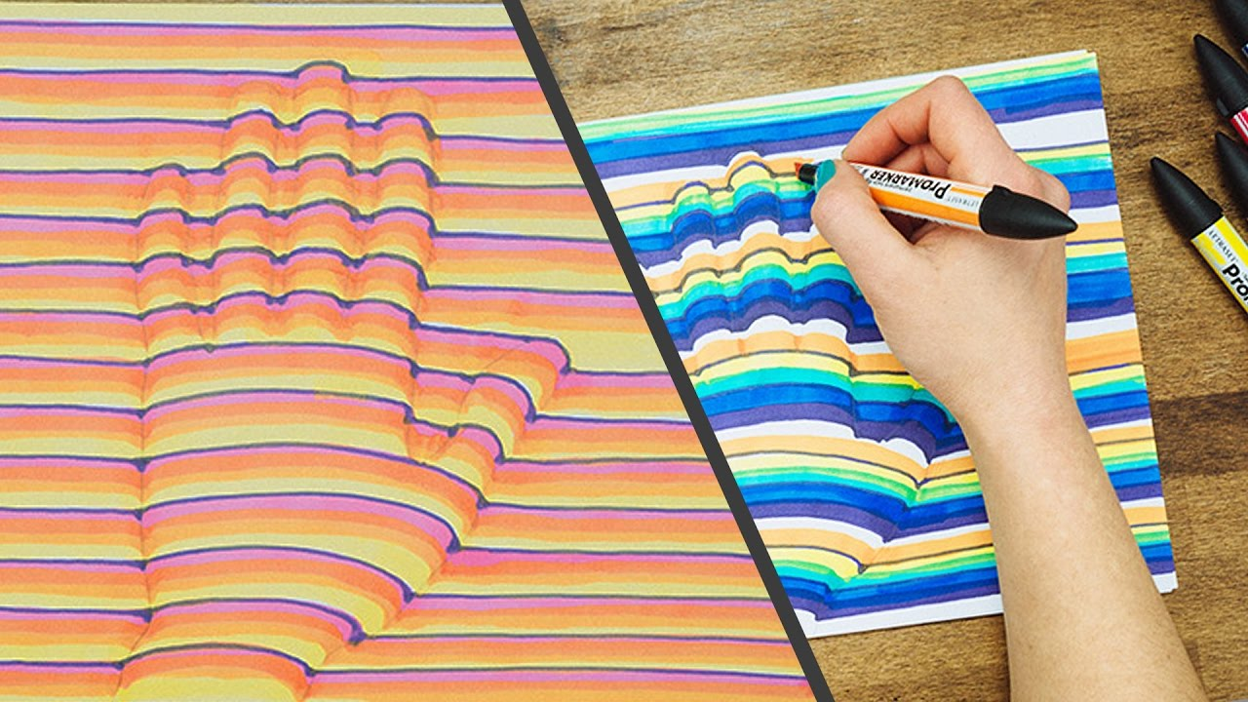
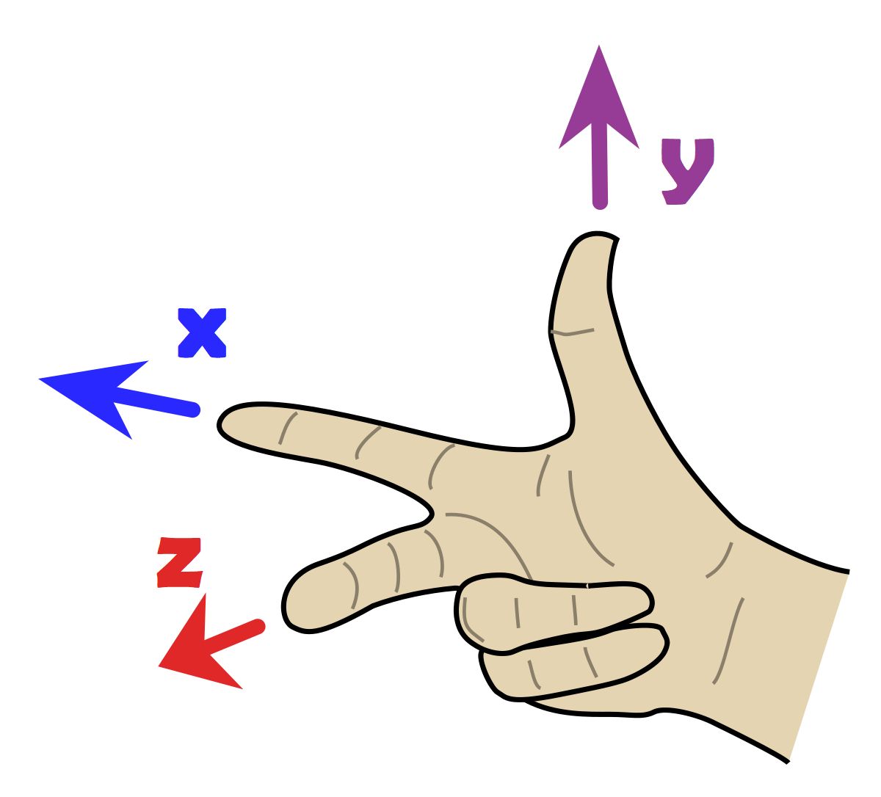
Z- Index

Slide 27
Let’s make shapes - CSS

Slide 28
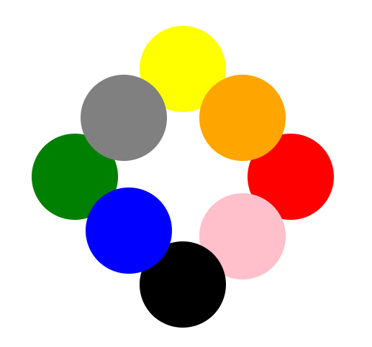
Play around with circles

Slide 29
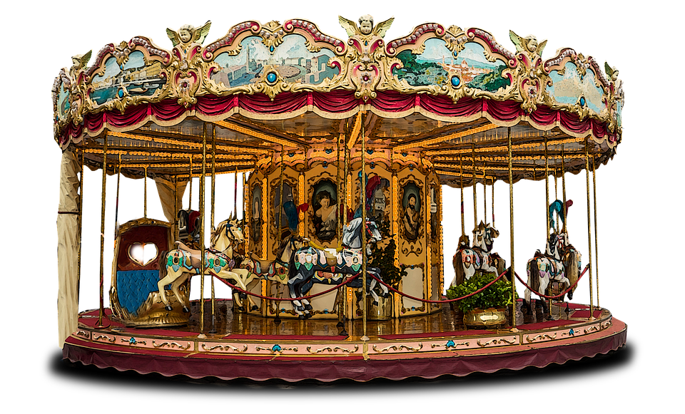
Carousel
We can take a complex file
And still change something
And customize it

Slide 30

Final Presentation
Brainstorm an idea for your final project:
Problem/question that can be solved with a pattern
Access full description for each day here: bit.ly/patronx

